Slide 1
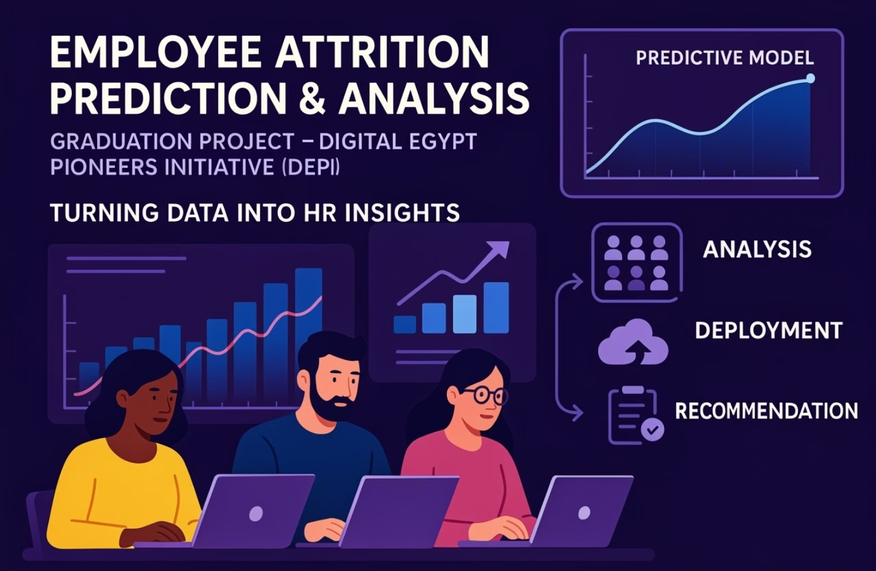

Slide 2

Meet the Team
1
Ibrahim Abdelsattar - Team Leader, (Milestone 1&2&5)
2
Ali Madian - (Milestone 1&2)
3
Ahmed Tarek - (Milestone 3)
4
Reem Ashraf - (Milestone 3)
5
Yousif Saad - (Milestone 4)
6
Mohamed Abd el-meged - (Milestone 4)

Slide 3






Agenda Overview
Project Timeline, Introduction and Objectives:
Define scope and goals for attrition prediction.
Data Analysis and Preprocessing:
Explore data quality and preparation steps.
Modeling and Evaluation:
Build and assess predictive models.
Deployment and MLOps:
Strategies for operationalizing the model.
Recap, Q&A, and Conclusion:
Summarize findings and address questions.

Slide 4




Project Timeline
Data Collection and EDA
Duration: 1 week
Gather data and perform initial exploration to understand patterns.
Data Preprocessing and Feature Engineering
Duration: 1 week
Clean, transform data, and create meaningful features for modeling.
ML Model Development and Optimization
Duration: 2 weeks
Train models, tune hyperparameters, and improve predictive accuracy.
MLOps and Deployment
Duration: 2 weeks
Automate deployment and monitoring for sustainable model operation.

Slide 5






Project Introduction and Objectives
Employee turnover remains a significant concern for organizations worldwide. Recent data indicates that the average global employee turnover rate is approximately 20%, with certain industries, such as retail, hospitality, and technology, experiencing even higher rates. Notably, voluntary departures constitute about 70% of these turnovers, often driven by factors like burnout, limited career advancement, and dissatisfaction with work-life balance. Keevee
This high turnover not only disrupts organizational continuity but also incurs substantial costs. Estimates suggest that replacing an employee can cost between 33% to over 200% of their annual salary, depending on the role and industry. ​​Keevee
🎯 Project Objectives
Determine
Analyze
2
key factors contributing to employee turnover within the organization.
employee data to identify patterns and trends associated with attrition.
1
Understand
the underlying reasons behind employees' decisions to leave.
5
Provide
actionable insights and recommendations to enhance employee retention strategies.
Develop
4
predictive models to assess the likelihood of employee attrition.

Slide 6
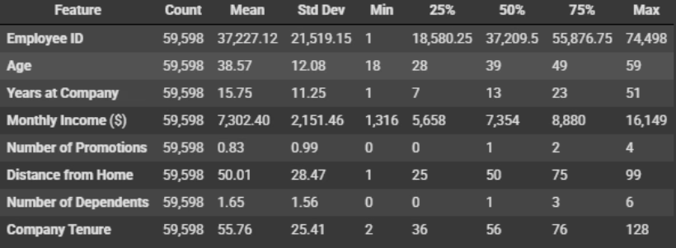
Data Overview & Wrangling
Dataset Summary
Data Wrangling Steps
59,598 employee records
No missing values
Features: Demographics, Career Info, Satisfaction Metrics
No duplicates found
Verified data types, removed irrelevant columns like Employee ID

Slide 7
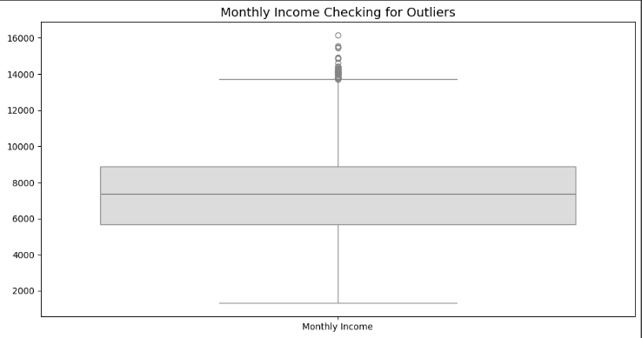
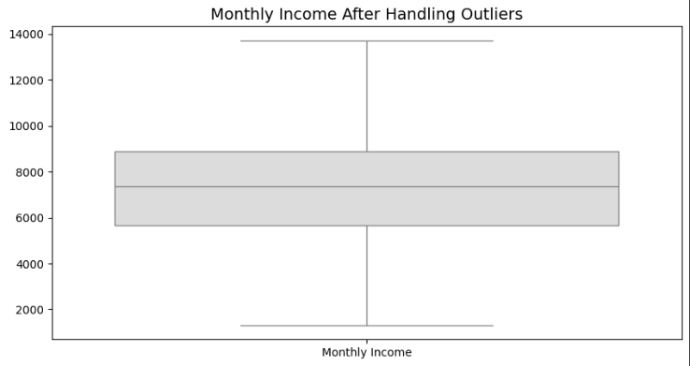
Handling Outliers
Winsorized 50 outliers in Monthly Income

Slide 8
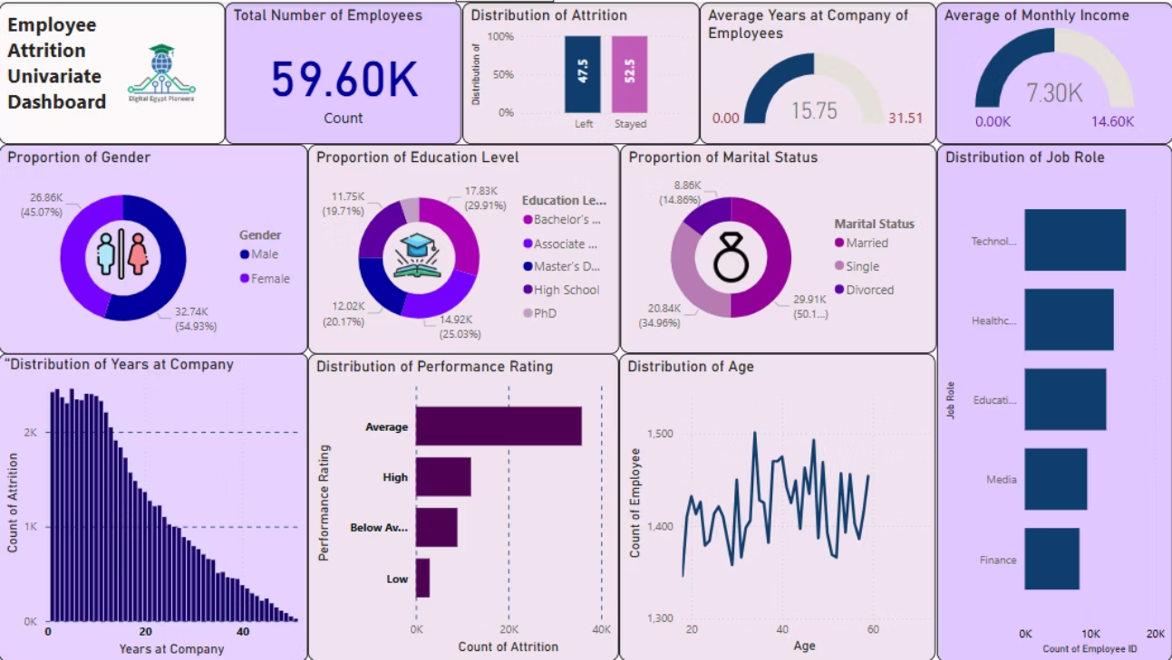
Exploratory Data Analysis
Univariate Analysis

Slide 9
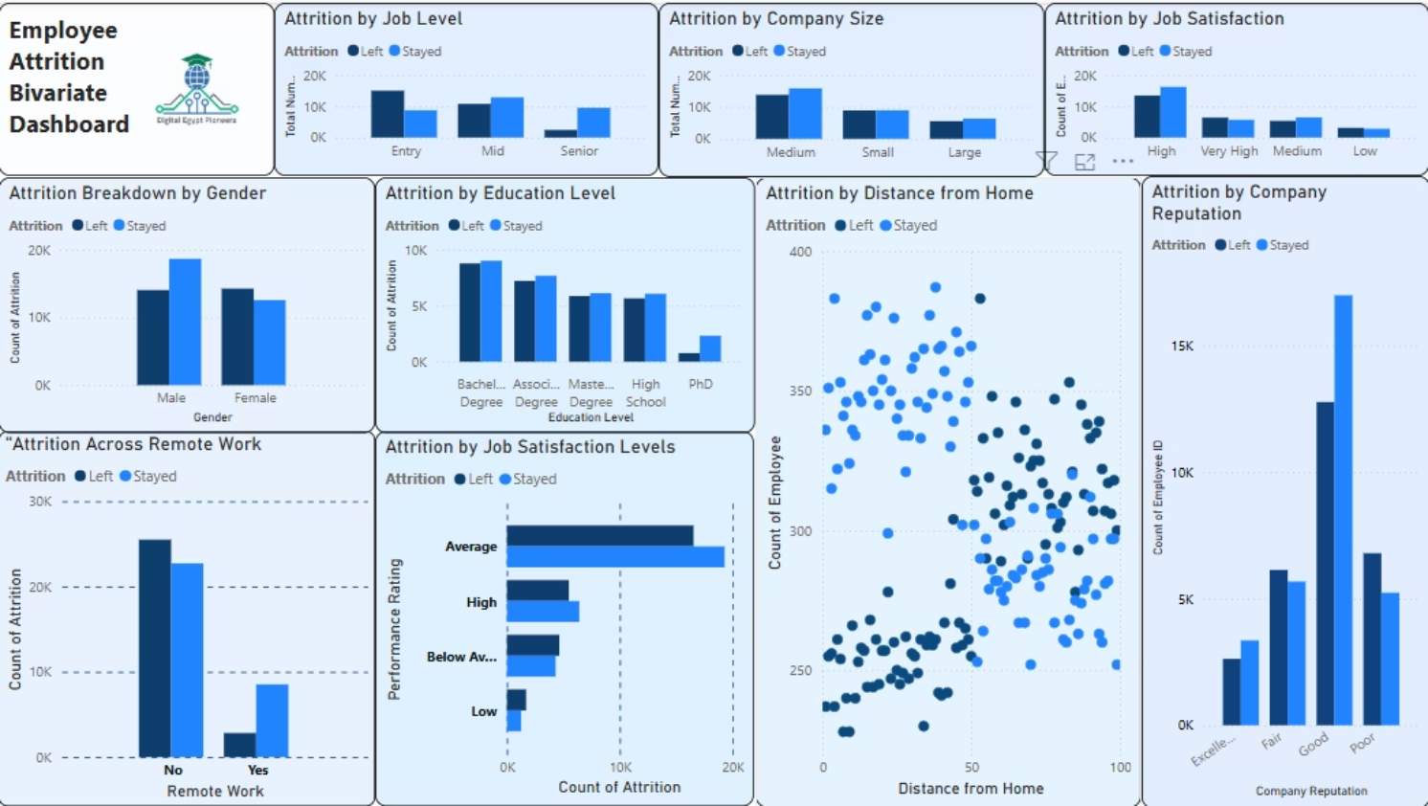
Bivariate Analysis

Slide 10

Top Strategic Recommendations to Reduce Attrition
Onboarding & Mentorship
Boost Job Satisfaction
Flexible Work Policies
Performance Coaching
Offer choice between office, hybrid, and remote work, especially for distant employees.
Provide strong training and mentoring for new hires during the first 6 months.
Conduct surveys and implement recognition programs and clear career paths.
Follow up with average-rated employees and provide personalized coaching.
Retention Plan
Develop tailored support plans for mid-sized teams and branches.

Slide 11
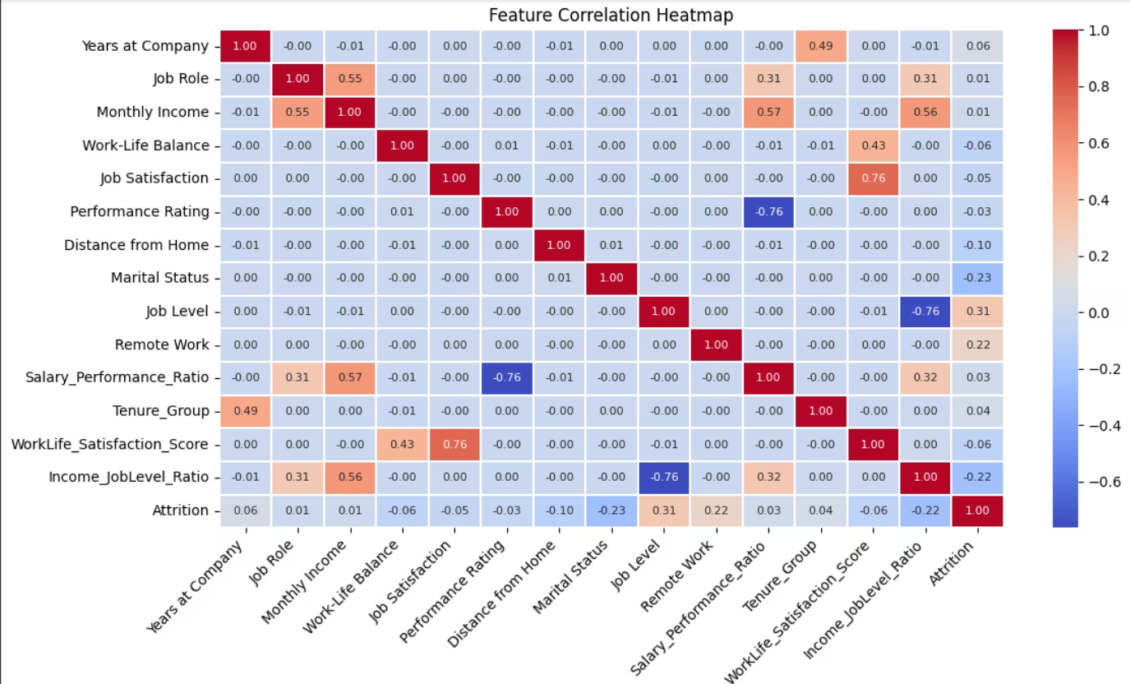
Multivariate Analysis

Slide 12

🔍 Insights from the Correlation Heatmap
📌 Attrition Correlation
💡 Strong Feature Interrelationships
Job Level shows a moderate negative correlation with Attrition (-0.31), meaning employees at higher job levels are less likely to leave.
Performance Rating is strongly negatively correlated with both:
Salary_Performance_Ratio (-0.76)
Remote Work (0.22) and Salary_Performance_Ratio (0.21) have positive correlations, indicating these employees are slightly more likely to leave.
Income_JobLevel_Ratio (-0.76)
Job Satisfaction and WorkLife_Satisfaction_Score are strongly positively correlated (0.76).
Performance Rating (-0.03) and Income_JobLevel_Ratio (-0.22) show negative relationships, implying that better-rated or more fairly compensated employees are less likely to leave.
📎 Other Observations
Marital Status has a moderate negative correlation with Attrition (-0.23), indicating married employees are less likely to attrition.
Tenure_Group and Years at Company are moderately correlated (0.49).
Monthly Income correlates moderately with:
Job Role (0.55)
Salary_Performance_Ratio (0.57)
Income_JobLevel_Ratio (0.56)
💬 Suggested Talking Points
Focus on Job Level, Remote Work, and Compensation Ratios as important features for attrition prediction.
Consider dropping one of the correlated salary metrics to avoid redundancy.
Support retention by improving compensation fairness and remote work policies.
Marital Status might serve as a relevant demographic indicator in attrition risk analysis.

Slide 13
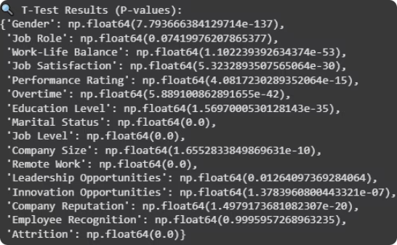
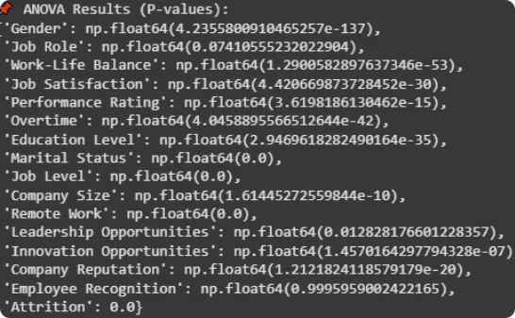
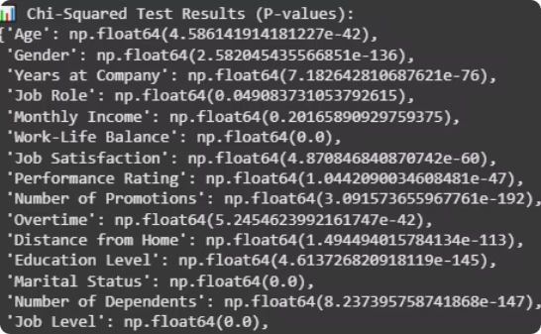
Advanced Data Analysis & Feature Selection
T-Test Insights
ANOVA Findings
Chi-Squared Test
Significant features include Gender, Work-Life Balance, Job Satisfaction, and Job Level.
Confirms impact of Marital Status, Performance Rating, and Remote Work on attrition.
Age, Number of Promotions, and Company Reputation strongly relate to attrition likelihood.

Slide 14
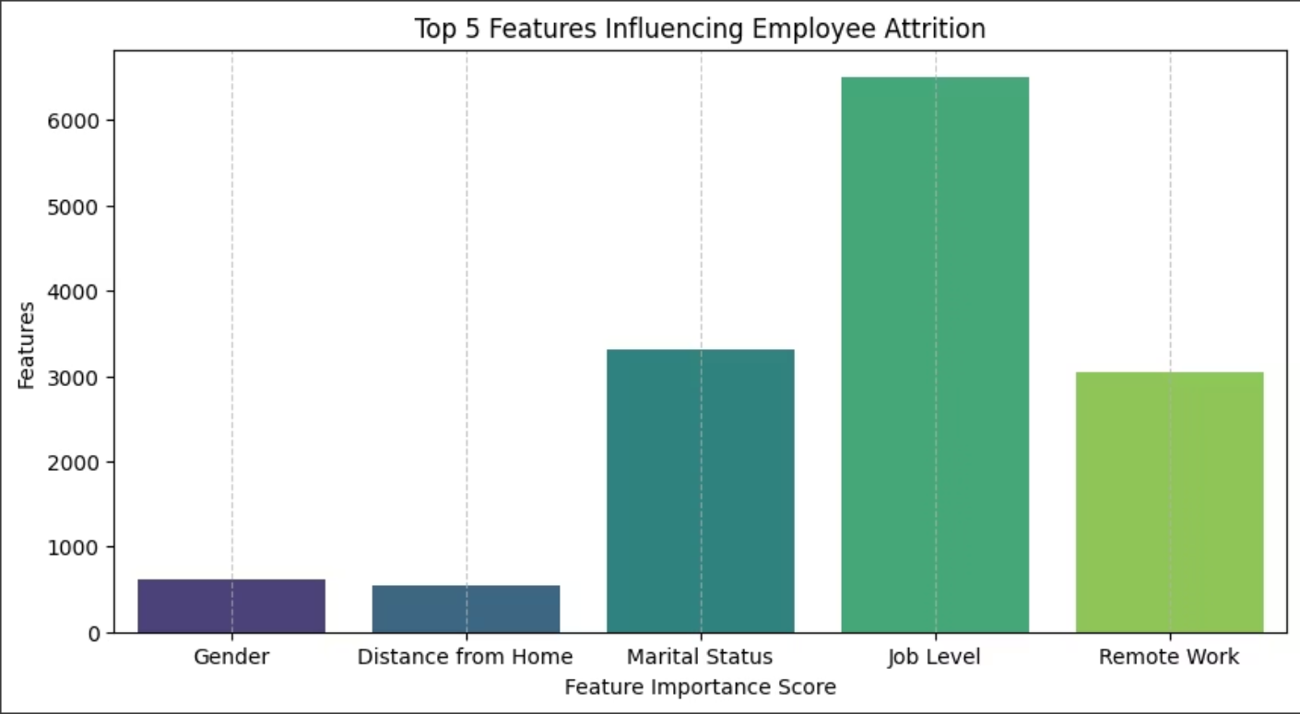
🚀 Top 5 Selected Features (SelectKBest - ANOVA F-test):
['Gender', 'Distance from Home', 'Marital Status', 'Job Level', 'Remote Work']

Slide 15

Data Preparation: Encoding & Normalization
Encoding Techniques
Normalization
Purpose
Label Encoding for binary columns like Gender and Remote Work
Applied to numerical features to ensure compatibility with machine learning algorithms.
Prepare data for effective model training and accurate predictions.

Slide 16

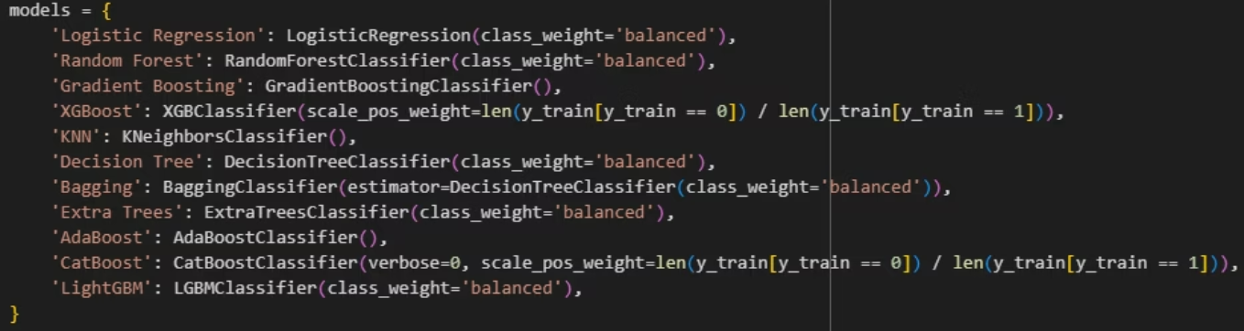
Machine Learning Model Development
Data Splitting
Handling Imbalance
80% training and 20% testing sets ensured robust evaluation.
Applied SMOTE to balance classes at 47% attrition rate, generating synthetic samples for the minority class.
Model Selection

Slide 17
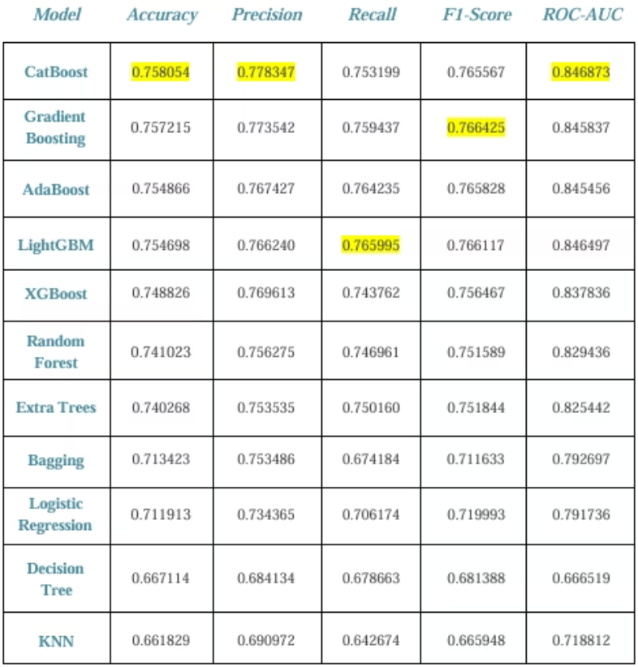
Before Anything: Models were trained on raw data to establish a performance benchmark.

Slide 18
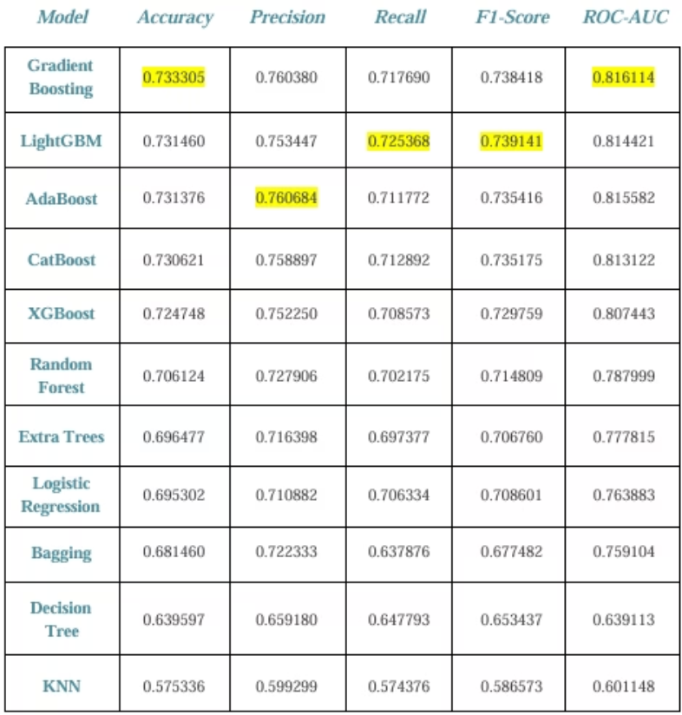
Before Feature Engineering: Models were retrained after applying encoding, scaling, drop unneeded columns, and outlier handling, improving performance.

Slide 19
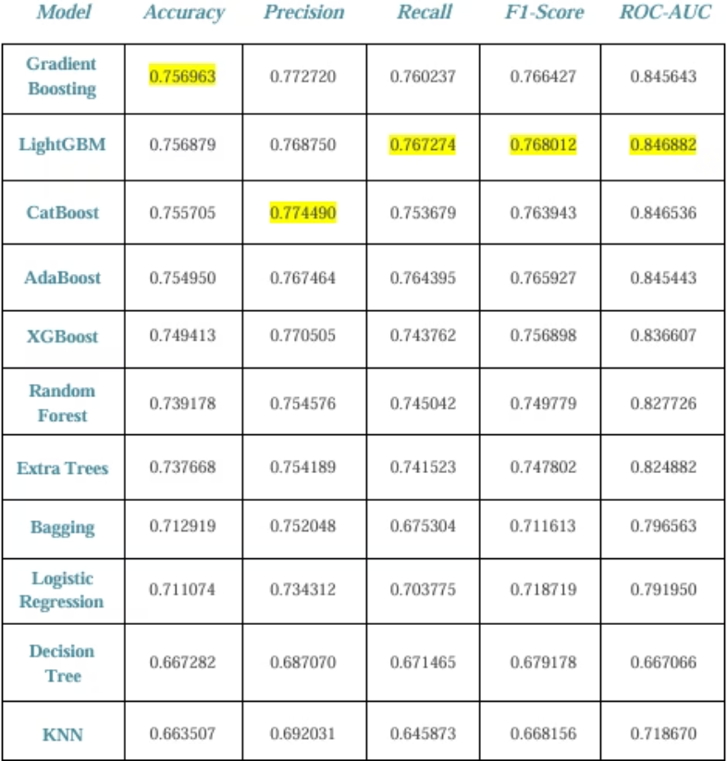
After Feature Engineering: Models were retrained after applying encoding, scaling, drop unneeded columns, Creating New Feature, and outlier handling, improving performance.

Slide 20
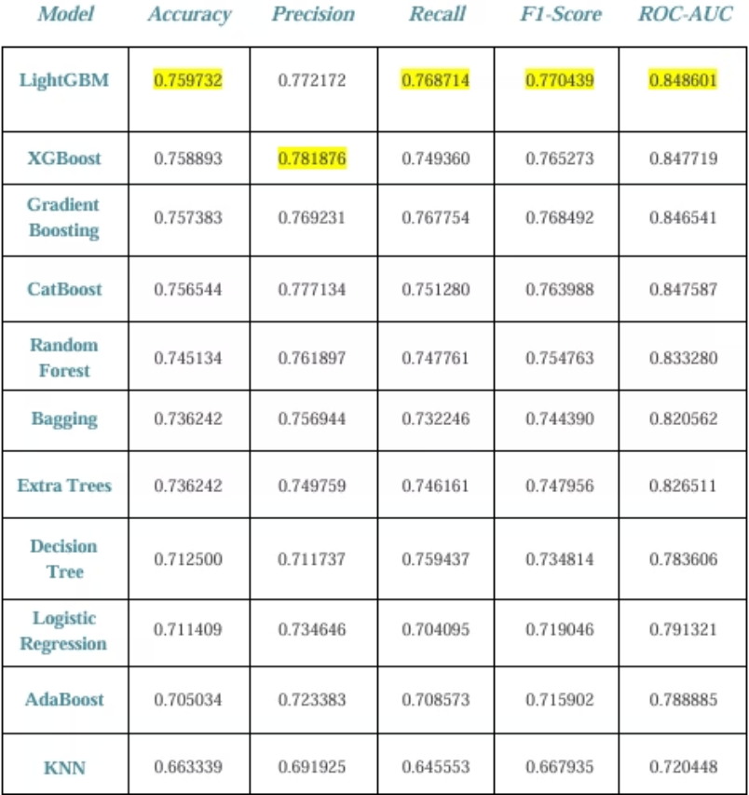
Fully Optimized Model Performance
(After Tuning): Models were trained with both feature engineering and hyperparameter tuning applied. This scenario showed the best performance, combining all enhancements.

Slide 21
Results and Strategic Recommendations
Top Performer: LightGBM model delivered highest accuracy and robustness.
Main Attrition Drivers: Low job satisfaction, below-market pay, and long hours without promotion.
Recommendations: Enhance salaries, improve promotions, and focus on career development.
Analytics Role: Use data-driven approaches regularly to predict and mitigate attrition risk.
Conclusion: LightGBM is ideal for production with regular updates for sustained accuracy.

Slide 22
Employee Attrition MLOps & Deployment
MLOps:
1
Objective: Build a scalable, reproducible, and production-ready ML pipeline for attrition prediction.
2
MLflow:
Used for experiment tracking and model registry.
Initialized experiments with mlflow.set_experiment().
Logged model parameters (e.g., num_leaves, learning_rate for LightGBM) and metrics (accuracy, precision, recall, F1-score).
Model Deployment
3
Flask API:
Enabled comparison and selection of the best-performing model via MLflow’s UI.
A RESTful API built with Flask accepts JSON-formatted employee data and returns predictions.
The model is loaded using mlflow.sklearn.load_model().
Designed for integration into backend systems.

Slide 23
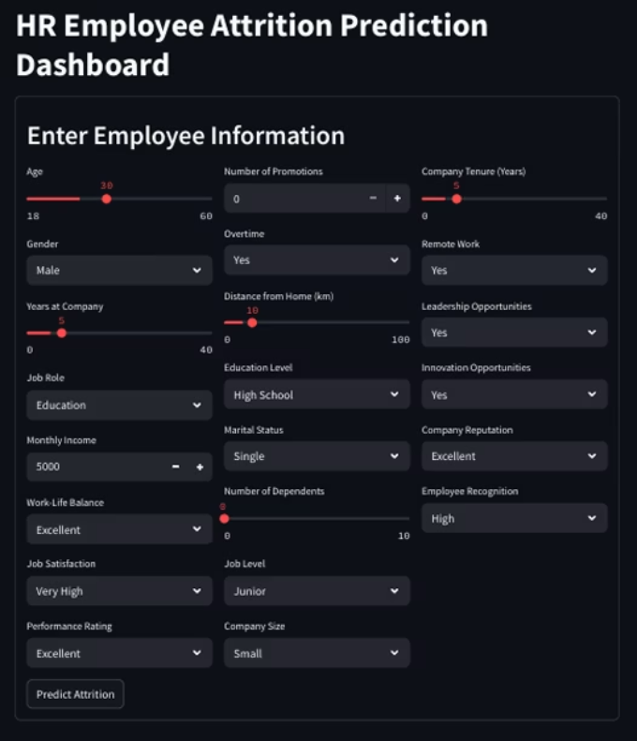
Streamlit Dashboard:
A user-friendly interface for HR personnel to input employee data and receive real-time predictions and explanations.
Ideal for business-facing applications and demonstrations.

Slide 24
Recap and Conclusion
Project Summary
Key Insights
Built an attrition prediction model combining feature engineering and hyperparameter tuning.
Low job satisfaction, pay gaps, and promotion delays are major attrition drivers.
LightGBM emerged as the most accurate and robust model for deployment.
Data-driven recommendations improve retention by targeting these key factors.

Slide 25

Q&A
Feel free to ask questions to deepen understanding or explore insights.

Slide 26
Thanks for Your Time
We appreciate your attention and engagement throughout this presentation.
Please reach out with any follow-up questions or discussion points.

